Slide 1
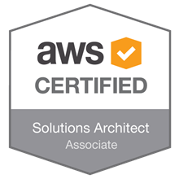
AWS-SA
Amir Khan

Slide 2
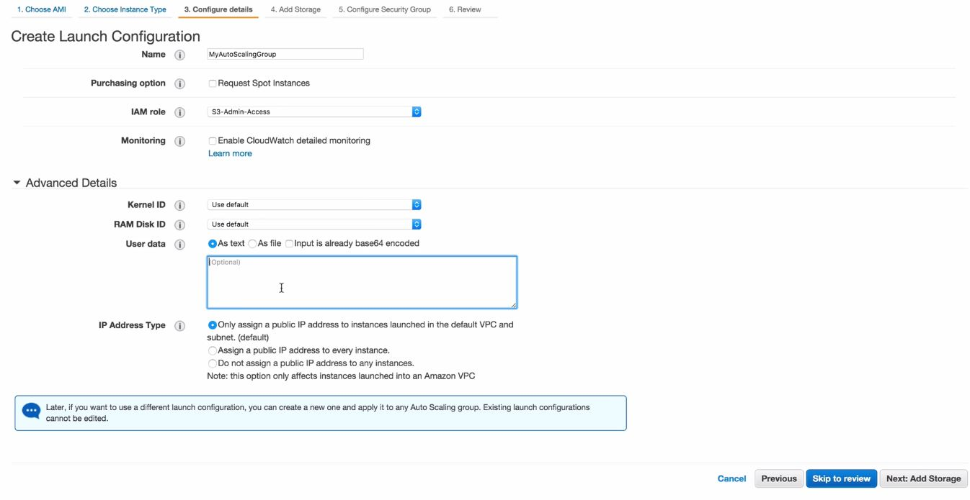
Autoscaling Groups
Autoscaling groups is defining a group that would scale up or down as per the rules defines in that group
In order to setup autoscaling groups we would need a launch configuration
We need to create a healthcheck file, this would be used by the autoscaling group to check the status of the instance
Launch configuration can be found under the EC2 dashboard
It's essentially the same steps that you would do while creating an EC2 instance

Slide 3
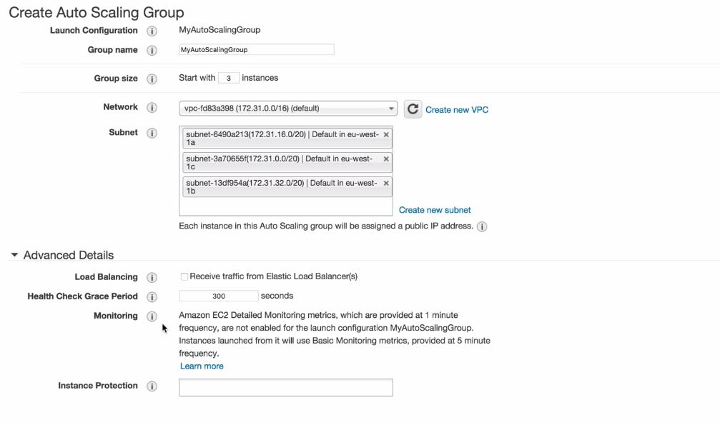
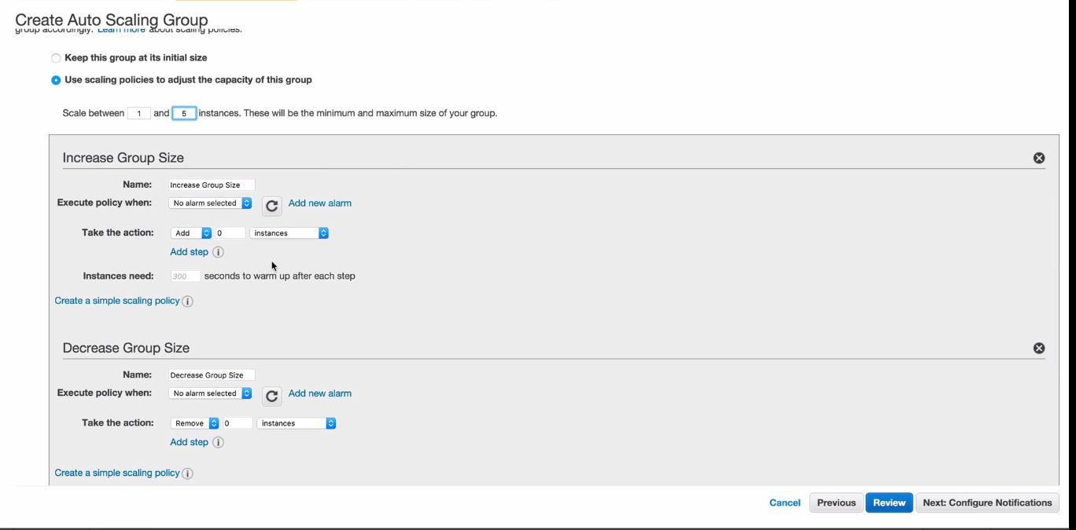
Autoscaling Groups
Once the launch configuration is done it will take us to the auto-scaling option
Group-size :- is the number of instance this autoscaling group would start with
Then select the VPC and then select the AZ
1 autoscaling group can span in one region only
It cannot provision the instance in another region
You can use route 53 and configure failover routing policy in case the entire region is down.

Slide 4
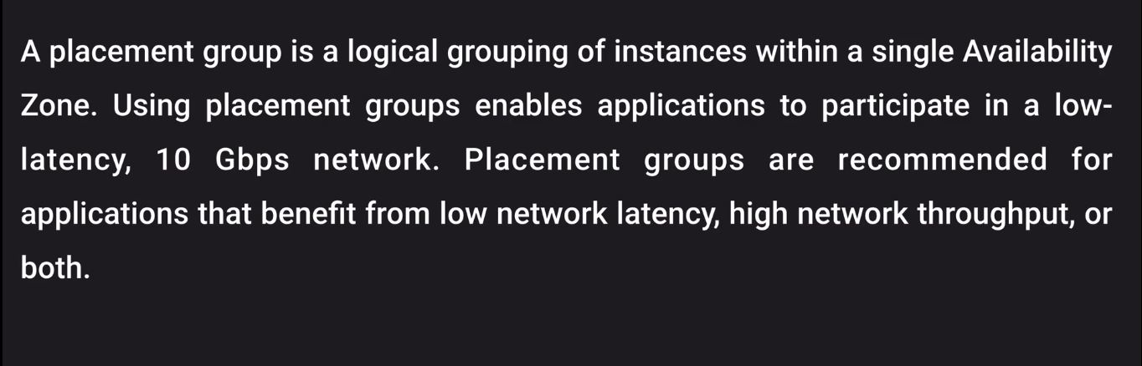
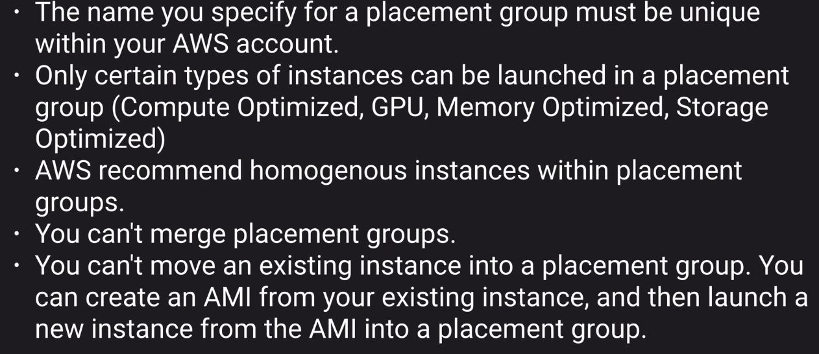
Placement groups
Now placement groups can span multiple AZ few use cases are hadoop cluster
Important key point for placement groups

Slide 5
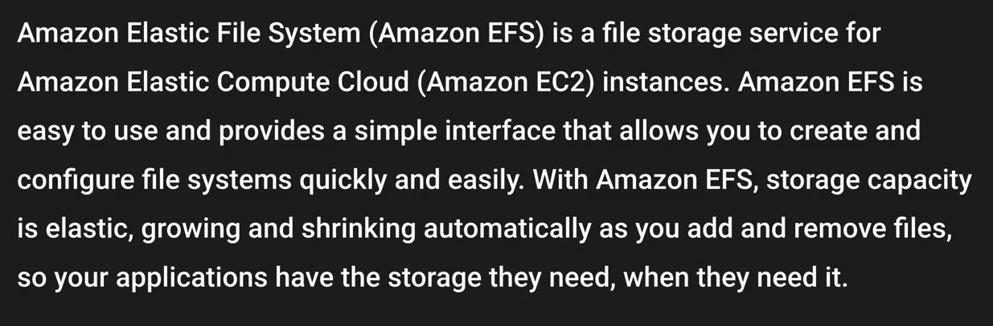
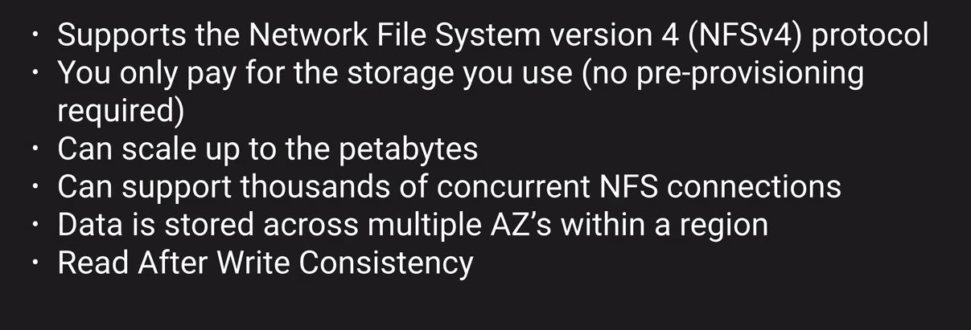
EFS
Basic advantage of efs/ebs is you can mount efs to multiple ec2 instance
You don't pre-provision any storage
EFS Features

Slide 6
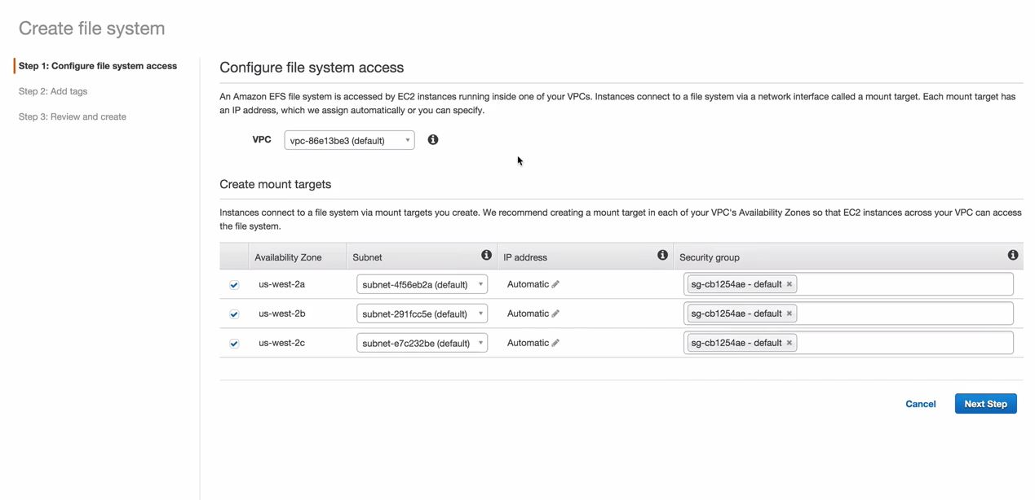
Create EFS
How to attach an EFS to a machine
You have to login to the machine first
In order to test this provision two ec2 instance and then attach EFS to them
Note :- in order to mount efs to an instance the instance and EFS should be in the same SG

Slide 7
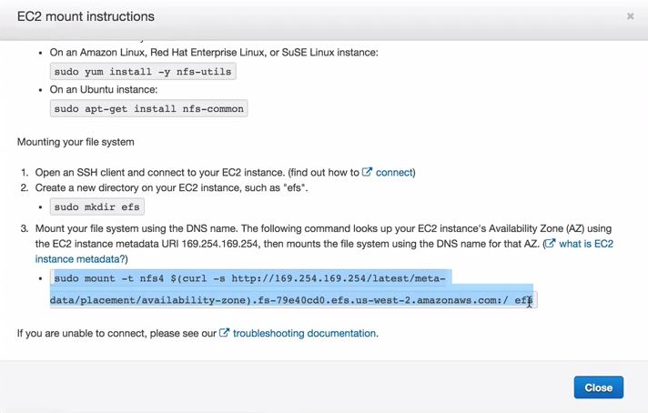
Create EFS
You can also use user level permissions and directory level permissions
Directory level permissions would be same across all the ec2 instance

Slide 8
Route 53
What is DNS ?
DNS is also known as domain name system can be related with your Phone book
If you want to find the contacts you will go to the name and find their contact details
Same goes with DNS as we all know that IP address is the thing that forms the core backbone of networking on how computers talk to each other on intranet as well as on internet
So, in order to make things simpler for humans to interact with different computers DNS came in to existence
DNS resolves computer names into IP address
There are two kinds of IP address
IPv4 and Ipv6
We all know that IPv6 came into being only because IPv4 were depletion
IPv4 has 32 bit of address and IPv6 is 128 bits
IPv6 is supported at the AWS services level and is also supported at the Route 53 service

Slide 9
Route 53
We would often see Dual stack when we would deal with service
Dual stack is nothing it means that the service supports both IPv4 and IPv6
Top level domain name
So if i talk about this with an example.
If you go to google.com, adobe.com
Whatever you see while looking at the name from reverse order after that is called as top level domain
And, the google or adobe is referred to as first level domain name
Top level domain names are maintained by IANA, it maintains a big database of all available top level domain names
In order to remove the duplicacy from first level domain names there needs to be someone to manage it
This is done by Domain registrar

Slide 10
Route 53
Domain registrar are organisation that provide you your domain name example :- Big rock, Go daddy
These domain names provided to you by the registrar are registered with interNic, which enforces uniqueness of domain names over the internet
Each domain name becomes registered in a central database
NS records :- NS records are used by the top level domain service to direct traffic to the content DNS server which holds the authorative DNS records
So in case if you have purchased a domain name from any other registrar then while creating a zone in Route 53 you get NS records and you share these NS records with them which they would utilize in order to route the traffic to your content
A record :- also known as address record. A record is used by a computer to translate the name of the domain to the IP address
A record will be used where you have an IP address
So in order to overcome this we use Alias records which is essentially similar to CNAME
Note :- you cannot use an A record for an ELB as they do not have an IP address

Slide 11
Route 53
TTL :- Time in seconds for which the DNS records would be cached either on the resolving server or on the local PC
So special care should be taken while changing over these names
So before the migration you should reduce the TTL so the PC does not have the old cached entry for the site that is being migrated
CNAME :- Resolve one domain name to another
Essentially what it is saying is you can create a record that would be resolving the same IP address
So rather than you have two A records you can have a CNAME
amir.com can be a CNAME for amir.corp.adobe.com
Alias :- this is a record which AWS has created and it is used with route53
It is similar to CNAME and is used to map resource record set where you do not get an IP address
Example
ELB, S3 buckets that are configured as website

Slide 12
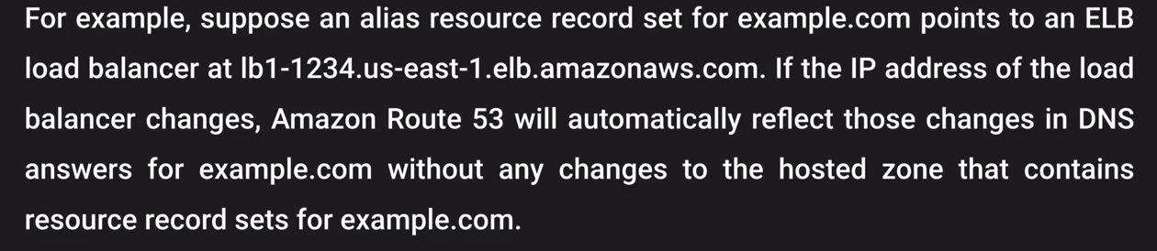
Route 53
Note :- CNAME can't be used for naked domain names. You have to have an A record for naked domain names. naked domain names is nothing but your domain name without www
So as you need an IPv4 address for naked domain names and since with ELB we don't get this we use Alias records
For CNAME you would be charged however for alias record you are not going to be charged for it

Slide 13
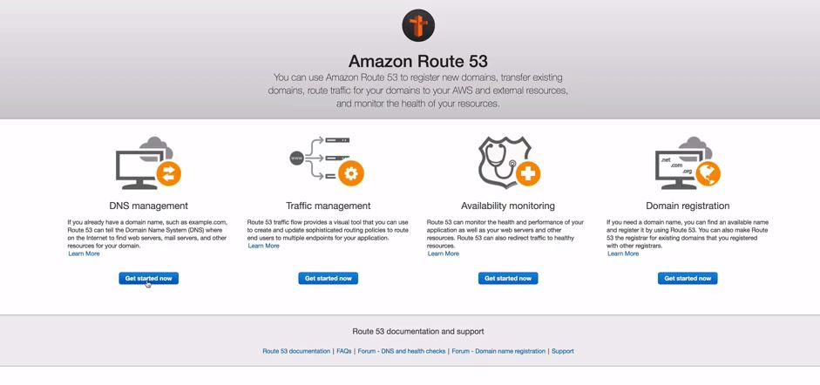
Route 53
How to register a domain name ?

Slide 14
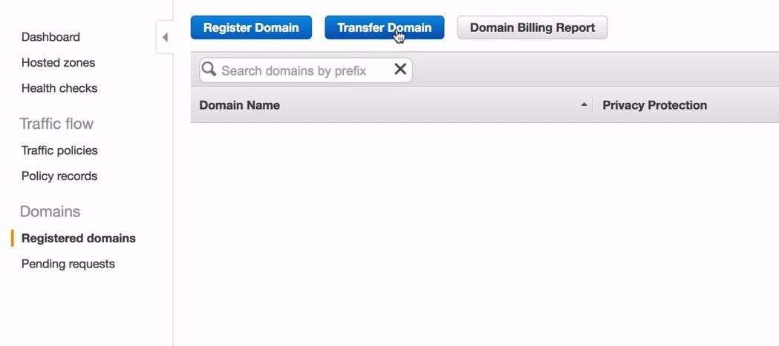
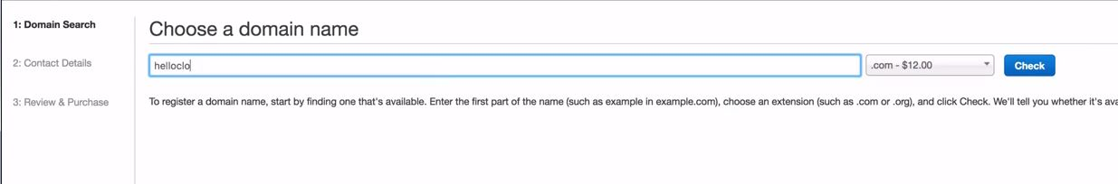
Route 53
How to register a domain name ?

Slide 15
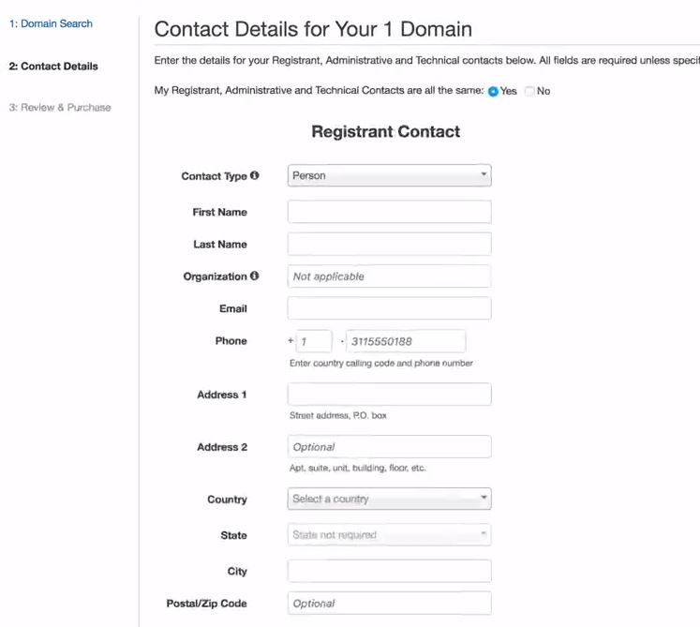
Route 53
How to register a domain name ?

Slide 16
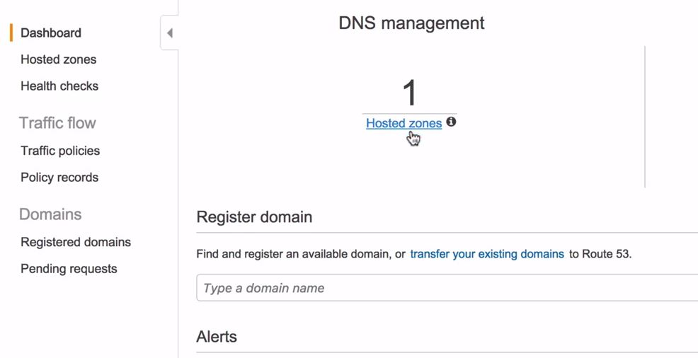
Route 53
Once you have registered your domain it would show you under your registered domains

Slide 17
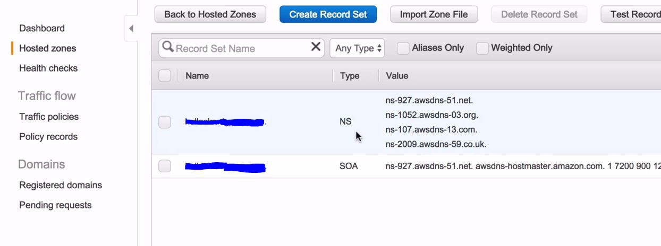
Route 53
Once you are in hosted zones you will find your domain name and once you click on that this would be the screen presented to you

Slide 18
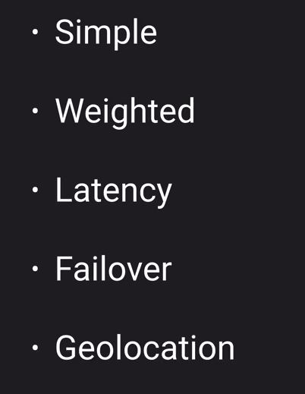
Route 53
So what we can do we can get two instances and create two webservers with the same content
Now we will create a load balancer and would put this behind the load balancer as we did in our last lab
We can also create same setup in a different region
We can create alias records to point to our load balancers in different regions
There are 5 different types of routing policies

Slide 19
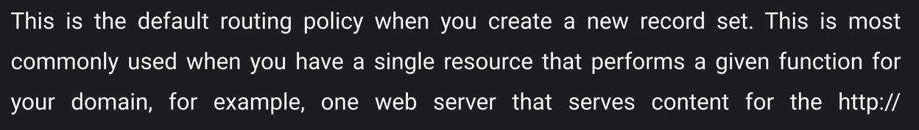
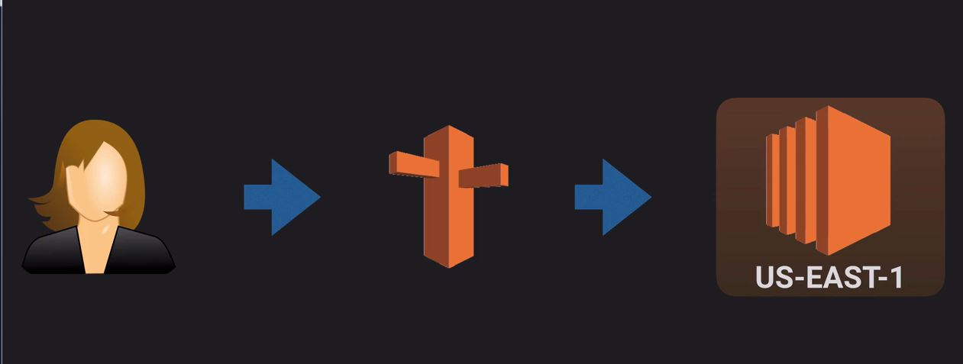
Route 53
Simple routing policies

Slide 20
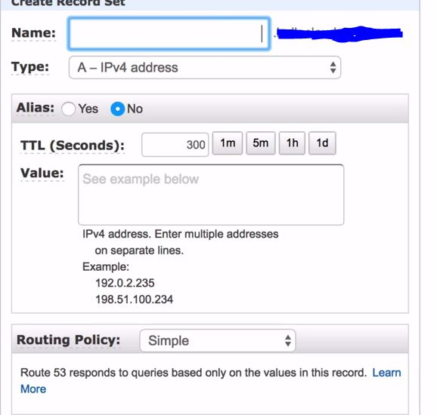
Route 53
In order to set this up
We have to go to the hosted zones
Create a record set for alias

Slide 21
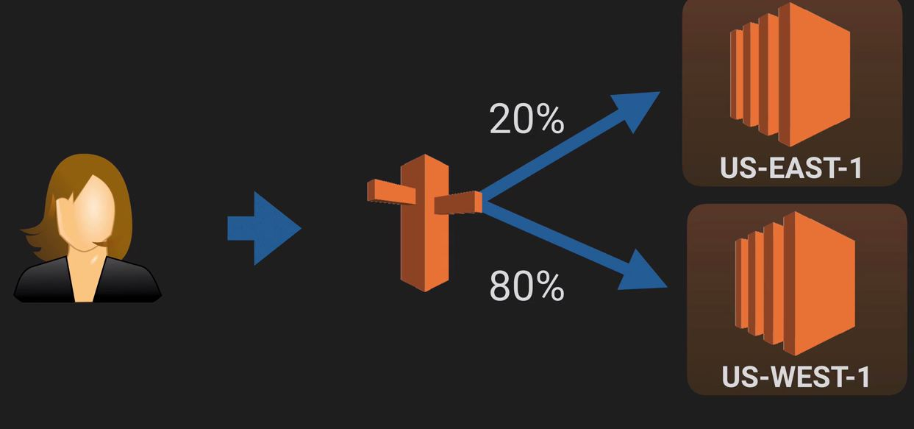
Route 53
Weighted routing
You can use weighted routing where in you can define routes based on a weight given to the record
It needs not be two different regions it can be done for two instances within the same regions or two LB within the same region

Slide 22
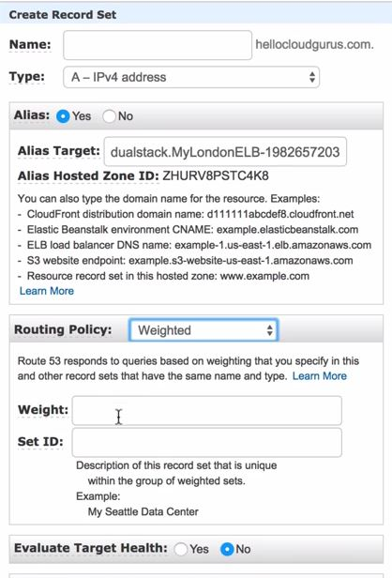
Route 53
Total weight and the weight that you have given will define the routing
For example
You have given a weight of 3 to one LB and 1 to one LB
That one that has 3 weight will get 75 % of the traffic

Slide 23
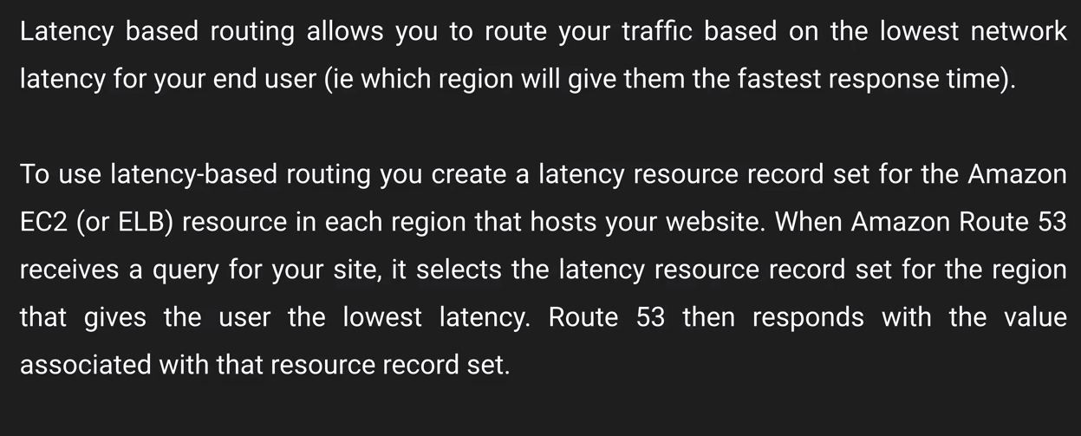
Route 53
Latency routing policies
It routes the traffic based on the lowest latency for end users

Slide 24
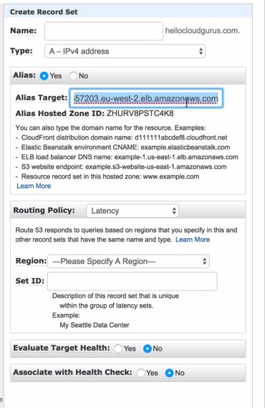
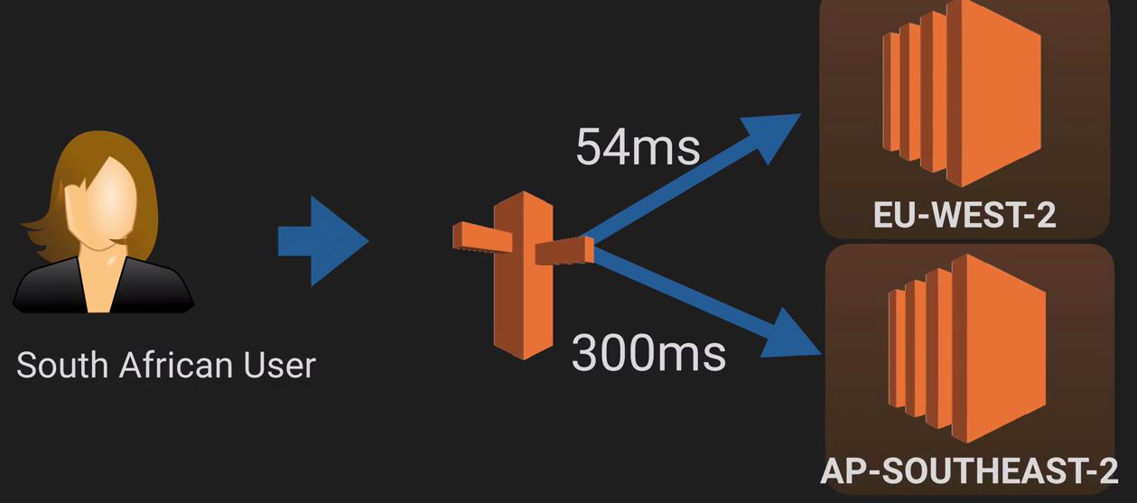
Route 53
Latency routing policies
Based on the latency for an end user traffic would be routed to that region.

Slide 25
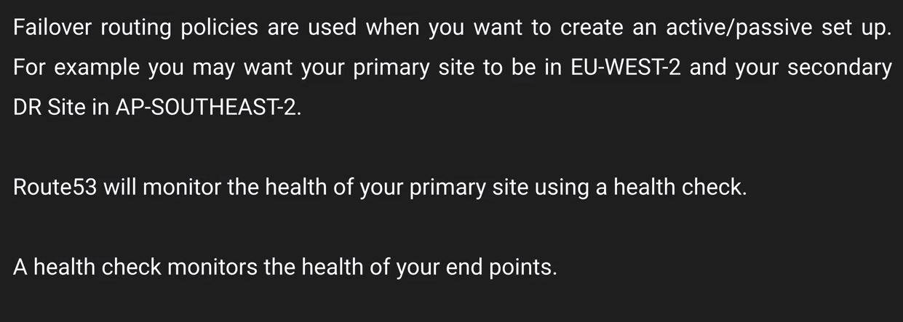
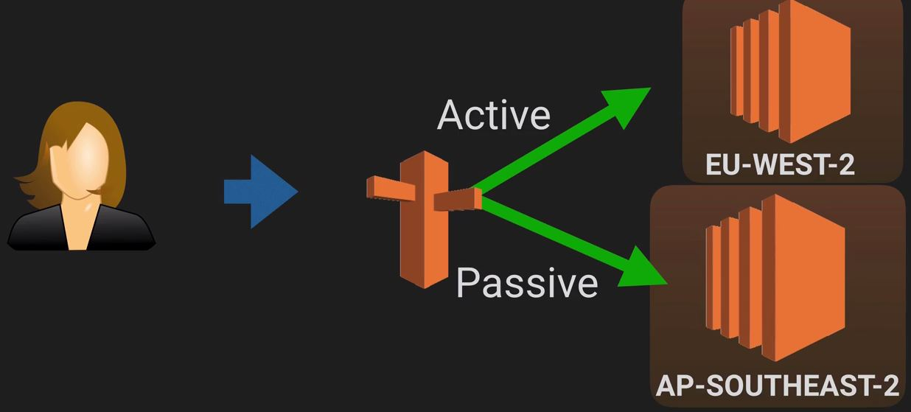
Route 53
Failover routing policy

Slide 26
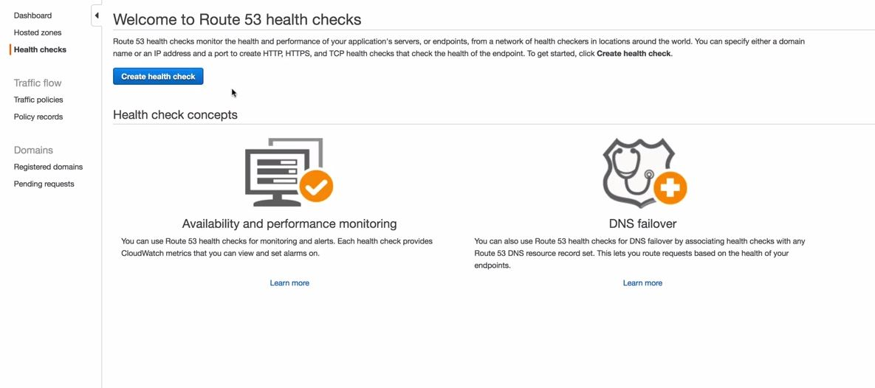
Route 53
Failover routing policy
For Failover we have to configure healthchecks and based on this healthcheck traffic would be routed to the DR site

Slide 27
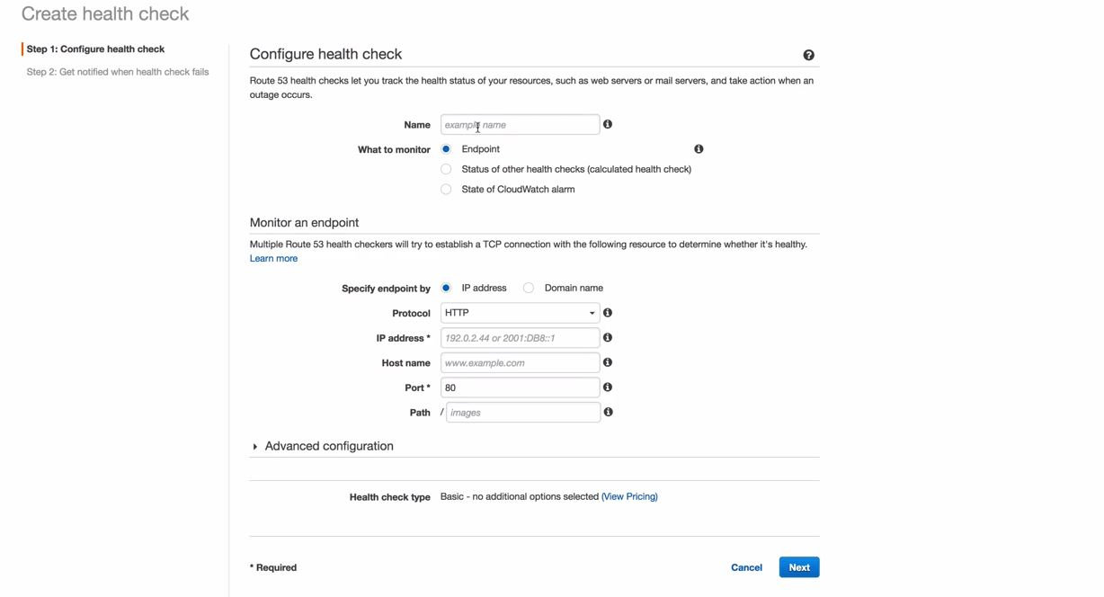
Route 53
Failover routing policy
For Failover we have to configure healthchecks and based on this healthcheck traffic would be routed to the DR site
Note :- You cannot associate a health check to check the same domain name as the record which you have configured in the healthcheck

Slide 28
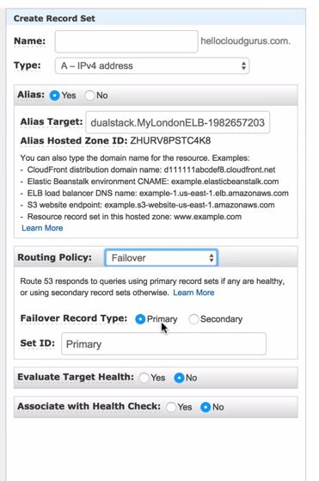
Route 53
Failover routing policy
You can configure alarms in order to send notification in case the health check fails

Slide 29
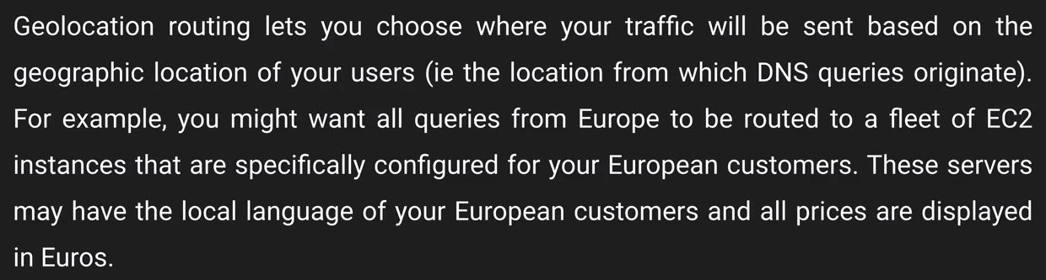
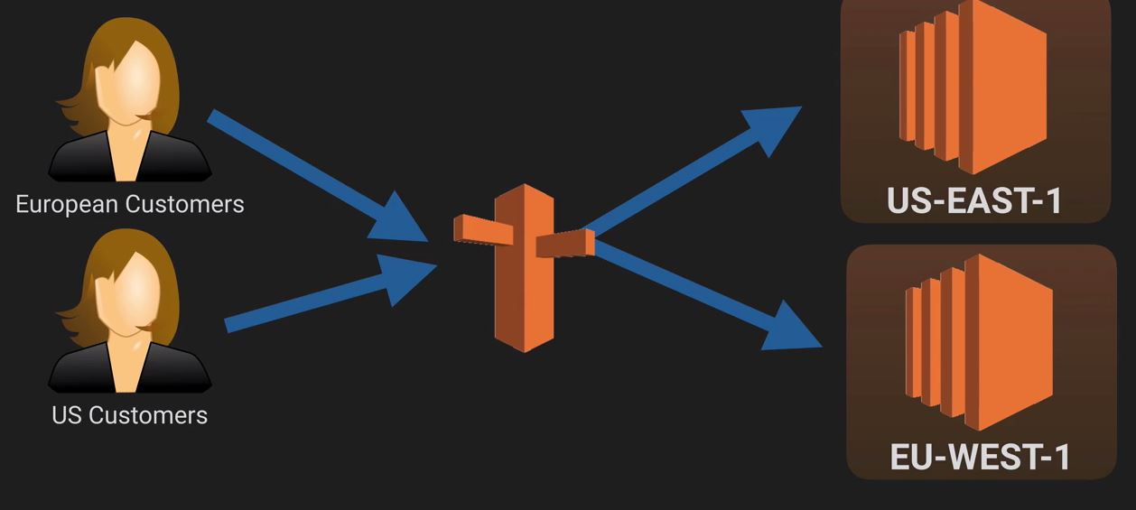
Route 53
Geo-location routing

Slide 30
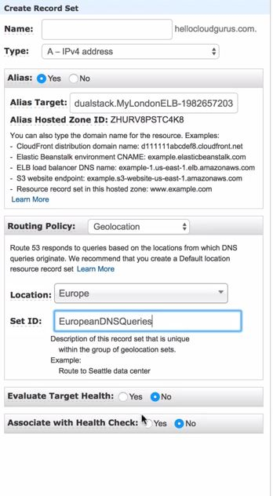
Route 53
Geo-location routing

Slide 31
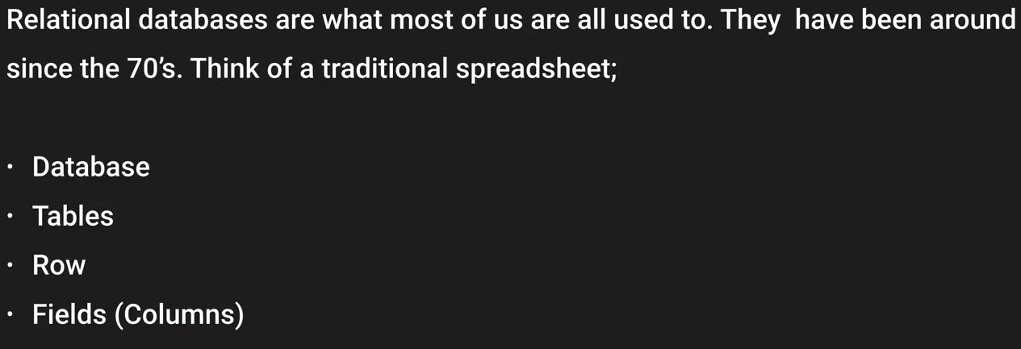
Databases
RDS → Relational Database services
Relational Database is like a spreadsheet
Name of the spreadsheet is like the name of the database
Tables can be related to the number of workbooks
Inside your tables/workbooks you have your rows and columns

Slide 32
Databases
RDS → Relational Database services
Each row is essentially a record
Each field contains the same type of data. Id :- will always be a number, First name :- will always be a string
RDS Database types
SQL server
MySQL Server
Oracle
Aurora
PostgreSQL
MariaDB

Slide 33
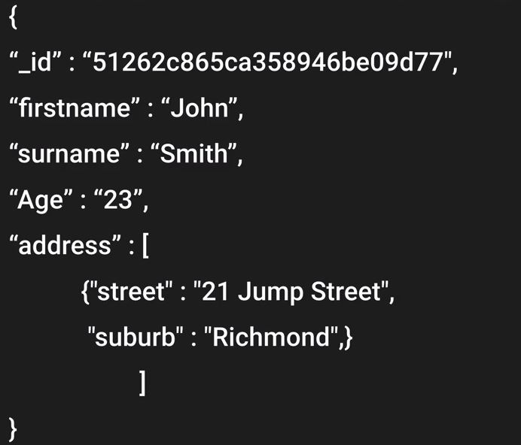
Databases
Non Relational Database
Example :- MongoDB. Couche DB
In Non relational database you have got your database and inside you got your collection
Collections can be referred to as tabled or workbooks
Tables consist of documents which are generally a record set or rows in your table
Key Value pairs :- fields within that table
With no SQL database you start a document with curly brackets

Slide 34
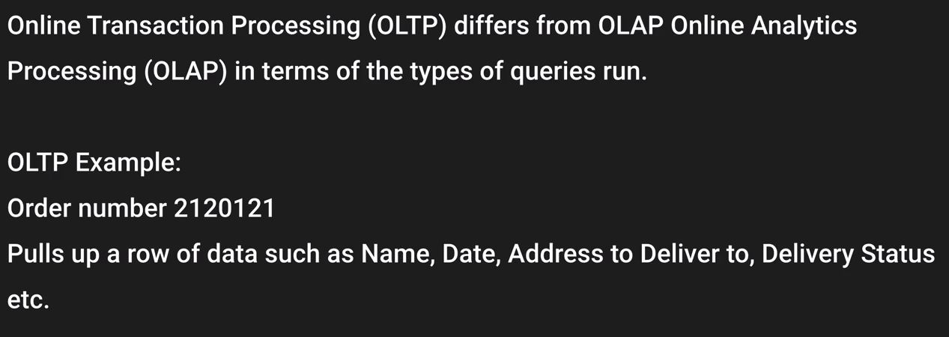
Databases
Data Warehousing
It is used for BI. It is used to pull in very large complex datasets and is used by management to find out profits
There are two different types of processing OLTP and OLAP
With OLTP it hits the database very lighty as when the queries is run there is just one resource record set that is being pulled

Slide 35
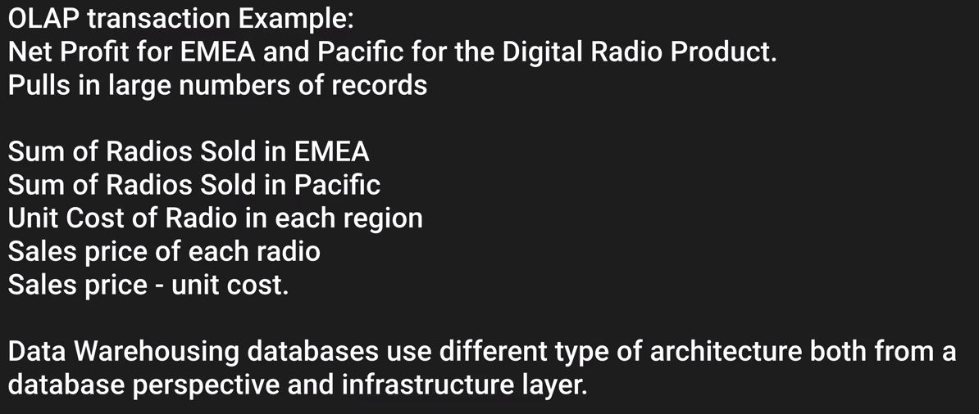
Databases
Data Warehousing
OLAP
As you can see that there is huge amount of data involved hence it would be hitting the database very hard
Hence for data-warehousing a copy of your production database is created and management runs their queries on it

Slide 36
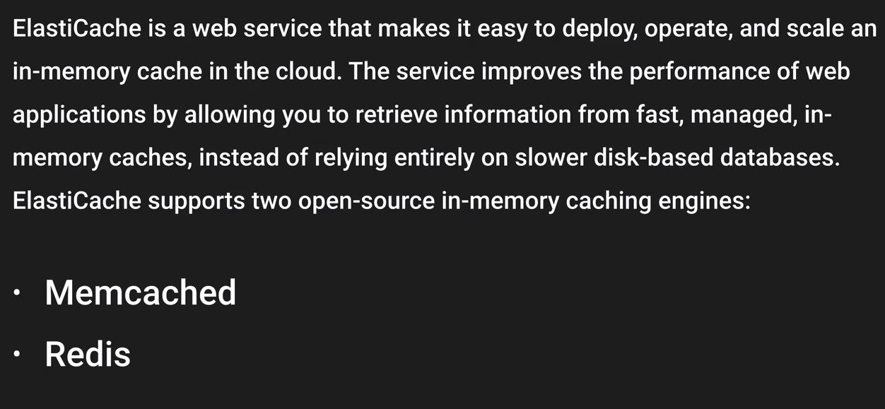
Databases
ElastiCache

Slide 37
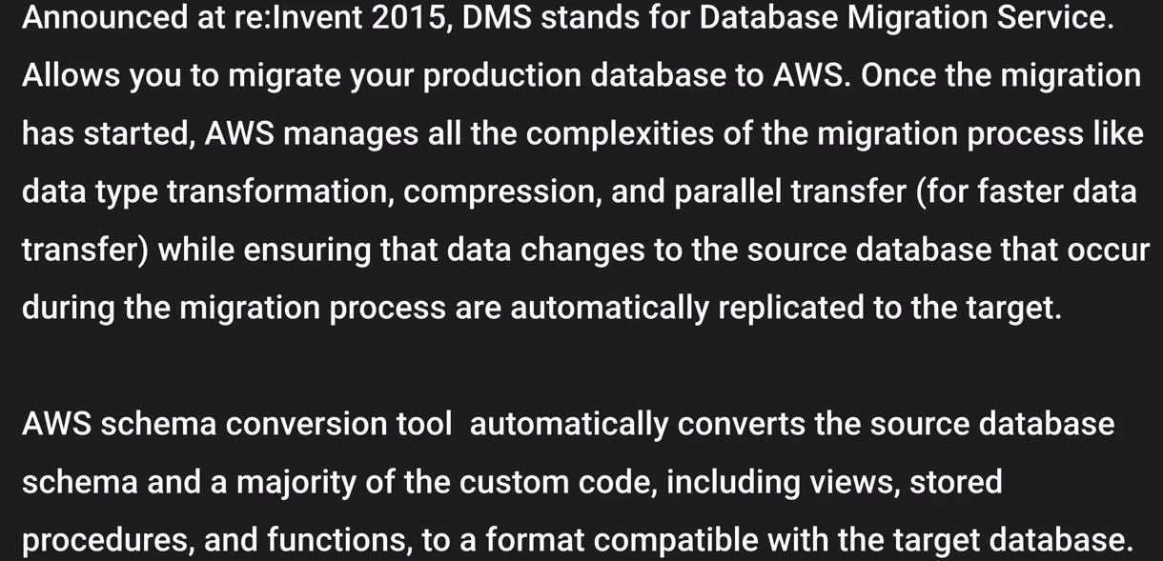
Databases
DMS
NOTE :- RDS is used for OLTP

Slide 38
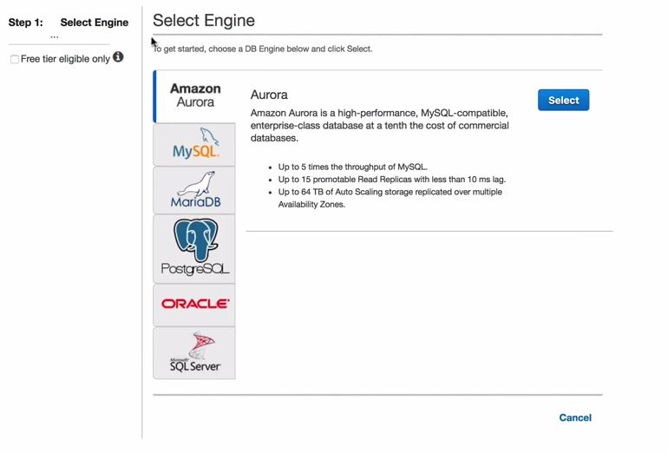
Databases
Let's create our first RDS instance
We will create a webserver and RDS instance and we will put them in two different SG and then we will connect our web server to our RDS instance
Navigate to Database and navigate to RDS and click on get started
Select the engine

Slide 39
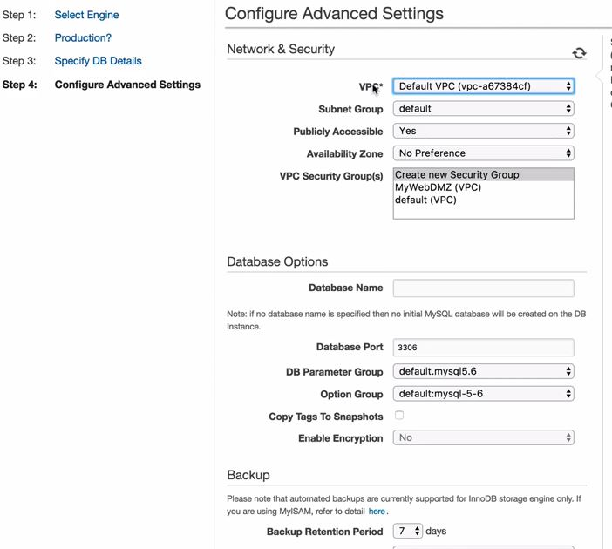
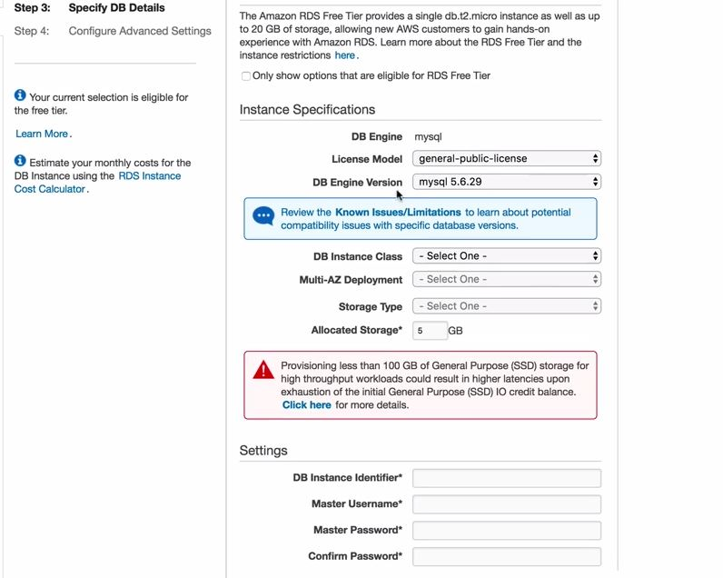
Databases
Let's create our first RDS instance
Select MySQL and choose dev and test

Slide 40
Databases
Let's create our first RDS instance
Leave everything as default and launch the instance
Check the SG that was created by the launch wizard
Change the Security group to allow connections from the SG in which you have your webserver in
Create Connect.php in any S3 bucket you can get the code from git account

Slide 41
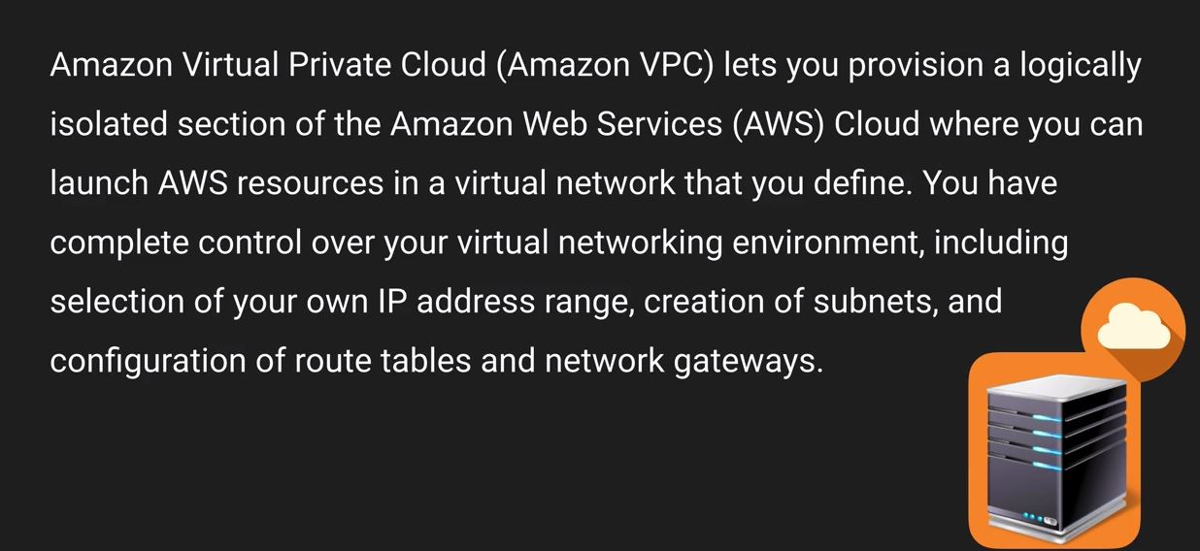
VPC → Virtual private cloud
VPC is really important and you must know in and out of VPC in order to pass the exams
It's your own virtual private DC in the cloud
Every region has a default VPC in every region

Slide 42
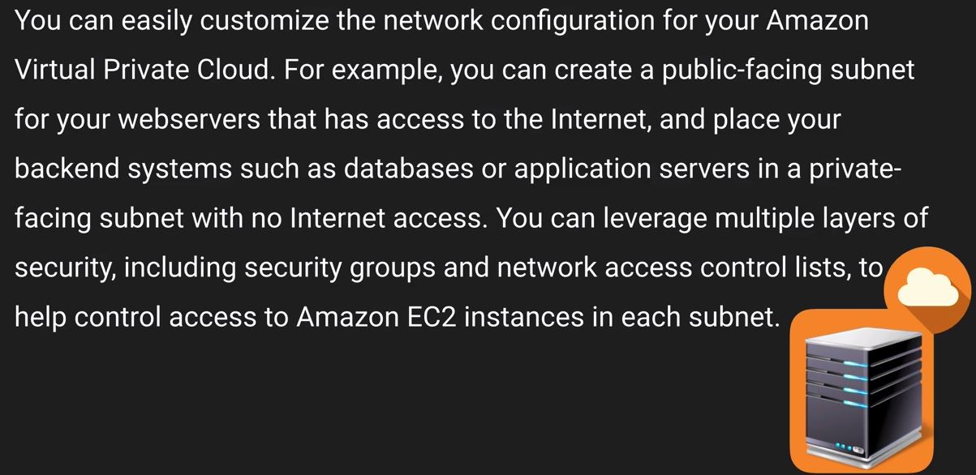
VPC → Virtual private cloud

Slide 43
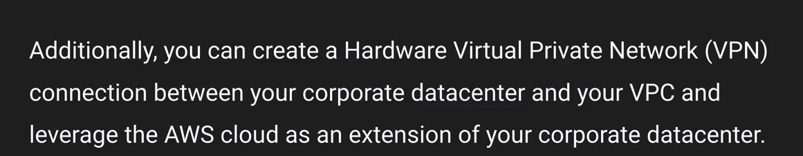
VPC → Virtual private cloud

Slide 44
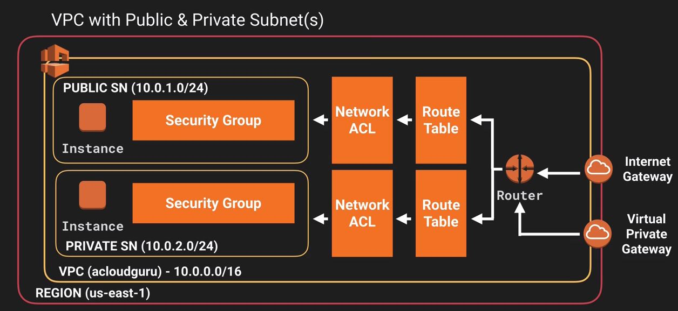
VPC → Virtual private cloud
How does a VPC looks like

Slide 45
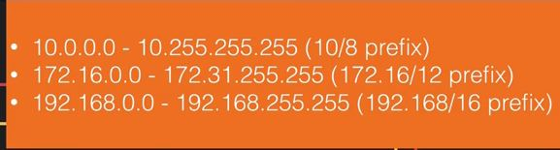
VPC → Virtual private cloud
Internet gateway :- is a gateway that would provide access to internet from your VPC
We have SG in our subnets
Security groups can be attached to different subnets.
The largest that we can have /16 CIDR
You cannot have more than 5 VPC in a region that is the soft limit
The smallest CIDR that you can have for a subnet is /28. That would give you 16 valid IP address
Note :- 1 Subnet = 1 AZ

Slide 46
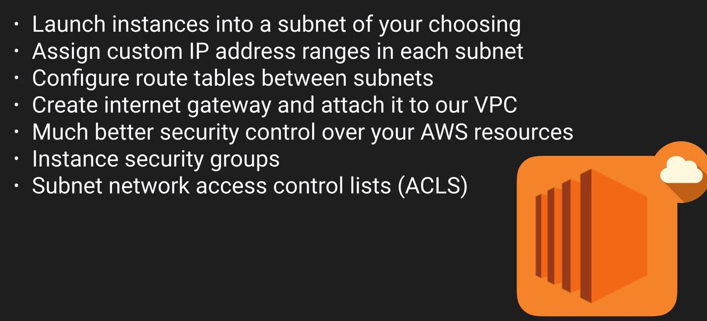
VPC → Virtual private cloud
We can create subnets and each subnets will go in different AZ.
Subnets should have different N/W address
What else you can do with a VPC ?
You can use private subnets to restrict internet access
Note :- You can only have one IGW with a VPC

Slide 47
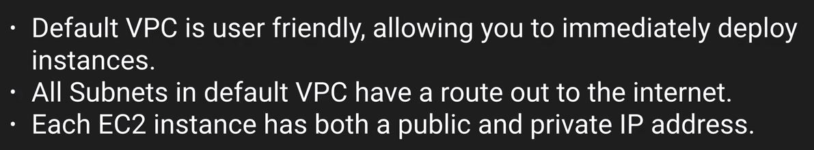

VPC → Virtual private cloud
What is the difference between custom and Default VPC ?
VPC Peering

Slide 48

VPC → Virtual private cloud
You can use private subnets to restrict internet access
VPC Peering (Star connection)

Slide 49

Let’s Create our own custom VPC
Let's go to networking and CDN

Slide 50

Let’s Create our own custom VPC
We can also start VPC wizard but that won't help and we will not learn anything
Now before we start i want you all to have a look on what we have right now with the default VPC
Subnets

Slide 51


Let’s Create our own custom VPC
Route Tables
Internet Gateways

Slide 52


Let’s Create our own custom VPC
Security Groups
We can check what security groups we have
Let’s create a custom VPC now

Slide 53

Let’s Create our own custom VPC
Use 10.0.0.0/16 for CIDR as /16 is the maximum that we can get.
Once the VPC is created you will find that there is no subnet created
You will find that there is one Route table is created and you will find that there is no IGW created
You will find that there would be NACL/SG created for the custom VPC

Slide 54

Let’s Create our own custom VPC
You can create subnets
Note :- US-east-1a can be a different AZ for you as it is for me, however the naming convention remains the same

Slide 55
Let’s Create our own custom VPC
You can define your manual CIDR
Let’s take 10.0.1.0/24 for one of the subnets
This would give you 256 address however you can only use 251 addreess
Create another subnet in a different AZ now
Take CIDR as 10.0.2.0/24
The 5 address that is not shown would be reserved VPC IP addresses
First 4 address and the last IP address is reserved
First one :- Network address
Second one :- VPC router
Third one :- DNS
Fourth one :- Reserved for future use
Last one :- Broadcast address
Note :- Since Broadcast is not supported in VPC that is why it is reserved

Slide 56

Let’s Create our own custom VPC
What essentially we have right now

Slide 57

Let’s Create our own custom VPC
Now we would create an IGW
Once you create it will be detached, then you need to attach it to the custom VPC.
Now as we all know that we already have a route table and the default route table would be allowing our subnets to talk to each other
Note :- In case you don’t explicitally assign any route table to any of the custom subnet these would be associated with the default route table

Slide 58


Let’s Create our own custom VPC
These two diagrams show us the Subnet association with the route table that gets created and the routes

Slide 59
Let’s Create our own custom VPC
Every time you create a new subnet it would be associated to your default route table as long as you explicitally associate that to a different route table

